Slide 1

Lecture 6
AJAX, Form and Dynamic Web Application

Slide 2

Agenda
AJAX Introduction
Request Module
Making Requests
Shorthand Methods
GET, POST, PUT, DELETE Requests
Form
Dynamic Web Application

Slide 3
AJAX Introduction

Slide 4
AJAX Introduction
AJAX stands for Asynchronous JavaScript And XML. It is not a programming language. It is a technology for developing better, faster and interactive Web Applications using HTML, CSS, JavaScript and XML.
HTML : Hypertext Markup Language (HTML) is used for defining the structure of a Web Application.
CSS : Cascading Style Sheet (CSS) is used to provide look and style to a Web Application.
JavaScript : JavaScript is used for making a Web Application interactive, interesting and user friendly.
XML : Extensible Markup Language (XML) is a format to store and transport data from the Web Server.

Slide 5
AJAX Introduction
AJAX is a developer's dream, because you can:
Update a web page without reloading the page
Request data from a server - after the page has loaded
Receive data from a server - after the page has loaded
Send data to a server - in the background

Slide 6
Request Module

Slide 7
Request Module
The Request module is one of the most popular Node.js packages for making HTTP AJAX requests.
It is just a wrapper around Node's native HTTPS module but is much more simple and more user-friendly.
When using Request, you can do all of the same things as the native HTTPS module but more easily.
Since Request is not a native module, we have to install it as an external dependency. Run the following command in your terminal to install through NPM:
npm install request --save
Once you have installed the Request module, you can require it in your code like below:
const request = require('request');

Slide 8
Making Requests

Slide 9
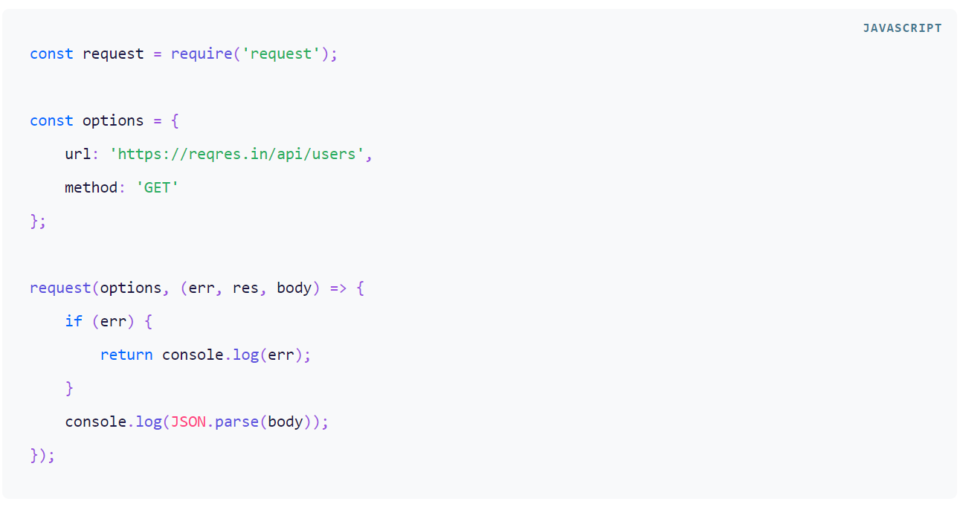
Making Requests
Making an HTTP request is as simple as passing a configuration object or just the URL to the request() method along with a callback function.
If an object is provided, it must contain a url property; if no method is specified, GET is used as the default value.
The code simply submits a GET request to our fake API to get a list of users. It parses the returned JSON response and then prints it to the console.﻿

Slide 10
Making Requests
The first parameter to the request() function can either be a URL string or an object literal. Here is a list of important configuration options that you can include in the object:
url — The destination URL of the request.
method — The HTTP request method like GET or POST.
headers — A list of HTTP headers as an object of key-value pairs.
json — A shortcut to add Content-type: application/json header. Additionally, parses the response body as JSON.

Slide 11
Shorthand Methods

Slide 12
Shorthand Methods
For convenience, Request also provides shorthand methods for sending different types of HTTP requests. The methods are as follows
request.get() — Defaults to method: “GET”
request.post() — Defaults to method: "POST"
request.put() — Defaults to method: "PUT"
request.patch() — Defaults to method: "PATCH"
request.del() / request.delete() — Defaults to method: "DELETE"
request.head() — Defaults to method: "HEAD"
request.options() — Defaults to method: "OPTIONS"

Slide 13
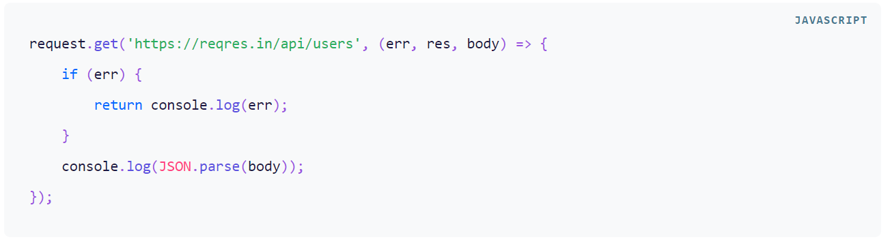
Shorthand Methods
Using the request.get() shorthand method, we can rewrite the above example as follows:

Slide 14
GET, POST, PUT, DELETE Requests

Slide 15
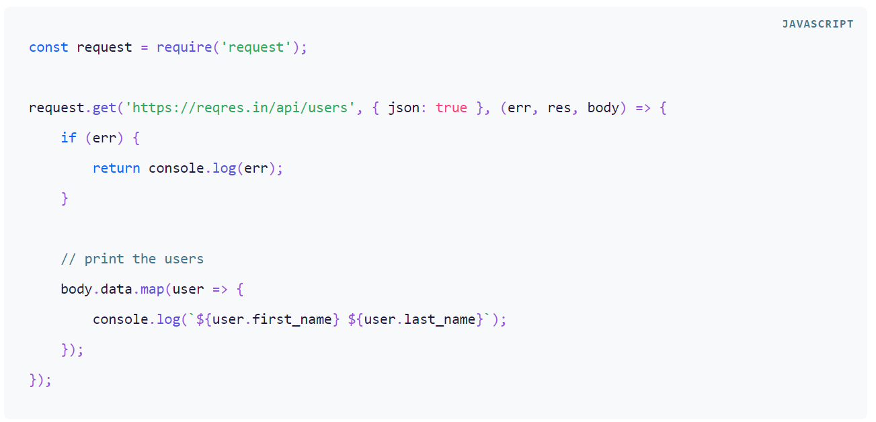
GET Request
Let us improve the above GET request to set the Content-Type to application/json and get users as a JSON object:

Slide 16
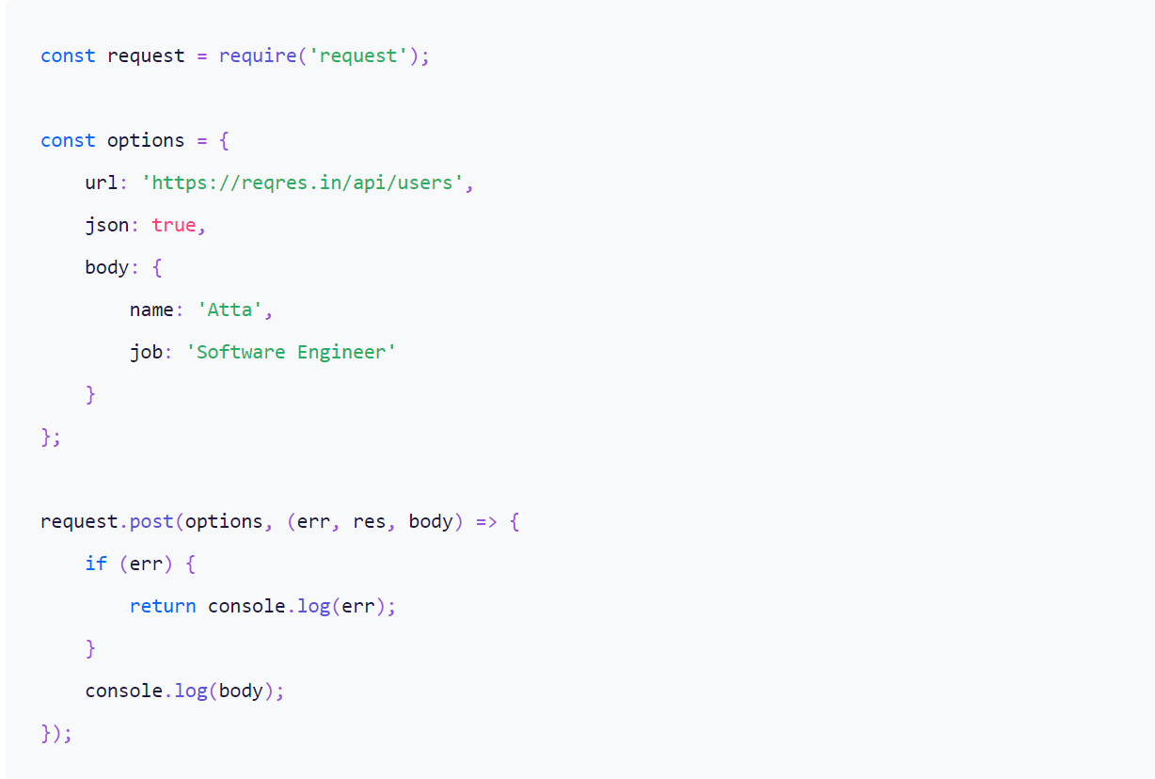
POST Request
Let us use the request.post() method to make an HTTP POST request with JSON data:

Slide 17
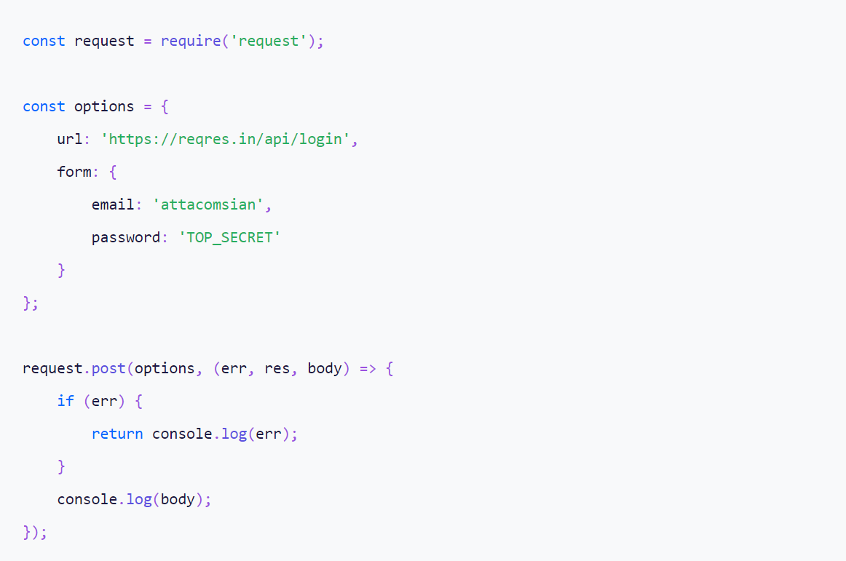
POST Request with application/x-www-form-urlencoded
The Request module supports the form requests out-of-the-box. Just use the form property in the options object to set the form data as key-value pairs.
The Request module will automatically URL-encode the data and set the Content-Type header to application/x-www-form-urlencoded.

Slide 18
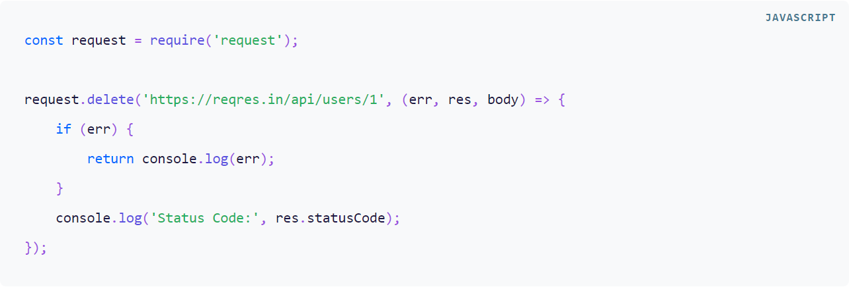
PUT and DELETE Requests
The PUT and DELETE requests are very much similar to a POST request. For PUT request, simply use request.put() method instead of using request.post() method.

Slide 19
Form

Slide 20
What is Form?
A Form is a HTML Form (you should have learn Form elements in previous lecture on HTML), we could perform Form submit with AJAX easily. AJAX form submitting allows you to send data in the background, eliminating the need to reload websites to see the updates. This makes the user experience much smoother.
By letting the browser and server exchange information without disturbing other activities, it saves both time and resources you would otherwise waste constantly reloading your site.
Let’s go through an example to understand how AJAX work with HTML Form submission.

Slide 21
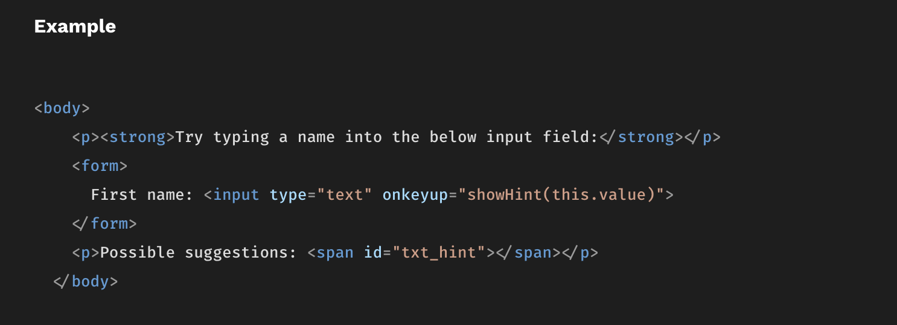
Form with AJAX
First of all, we create a simple input form using HTML:

Slide 22
Form with AJAX
We have create a HTML input element inside a HTML form here. When user input anything in the input box and want to submit the what they have input, they press the enter key to submit the form. So we create an onkeyup event listener on the input element, it will call the showHint function to handle user input value when the user click the enter key.

Slide 23
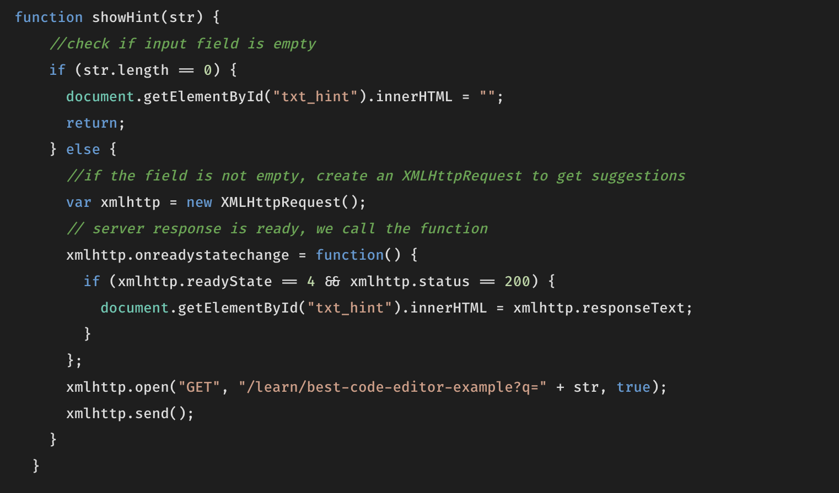
Form with AJAX
Then, let’s define the showHint function here, it will be triggered when form is submitted by user if they click the enter key.
Then, we create a XMLHttpRequest object, this is basically the native method allow us to make a HTTP AJAX request without using any existing AJAX module like the Request module we just introduced.

Slide 24
Form with AJAX
The xmlhttp object listen on the async GET request with the given url when we call the .open() method. The first parameter is the HTTP request method, second parameter is the url and third parameter “true” mean it is an async call, default is “true”.
the onreadystatechange is a callback function that handle logic after the request is called. we have the (err, res, body) callback in the request API of the Request Module which is more powerful than this native method.
The send method is to send the AJAX request call.

Slide 25
Form with AJAX
We send an AJAX GET request on the url “/learn/best-code-editor-example?q=” + str, then after the AJAX GET request is resolved, we get response from the xmlhttp.responseText, we assign the response text to HTML element with id “txt_hint"

Slide 26
Form with AJAX
With using Request Module, we could easily call a HTTP AJAX request easily using the request API or the shorthand method and omit this sophisticated and verbose XMLHttpRequest method.

Slide 27
Dynamic Web Application (DWA)

Slide 28
What is Dynamic Web Application?
A dynamic web application is a type of application that can change its content, appearance, and functionality in response to user input, system events, and information. Dynamic web applications may make use of features such as load-time data-driven forms, AJAX, databases, or other services that respond to external events.
Dynamic Web Applications can change their functionality without having to rewrite parts of their codebase. They offer developers an opportunity to create applications that can adapt based on user behavior and other external factors. Dynamic web application is a web application that can be offered under various configurations, depending on the needs of the user. These applications can present themselves differently to specific users based on authentication and other factors. Some examples of dynamic web applications are social media sites like Facebook, Twitter and Youtube. These sites not only show different content to people who log in using different means, but they also provide interactivity between users and allow them to express their personalities by posting pictures or writing comments.

